Slide 1


Dr. D. Y. Patil Pratishthan’s
Institute For Advanced Computing
and Software Development
E-DAC Oct 2020
A Project On
Service Centre Management System
Presented by
Mr. Rahul Eknath Ghuge
(PRN- 200941281131)
Under the Guidance of Center Coordinator Mr. Milind Arjun Mr. Prashant Karhale

Slide 2
Outlines:
Introduction
Scope
Motivation
Drawbacks of existing system
Operations
UML Diagram
ER Diagram
Application Flow
Backend Technologies
Future Scope
Conclusion
2

Slide 3
Introduction:
Vehicle servicing is something which is experienced by every owner of the vehicle.
And servicing can prove to be very costly or even damage the life of vehicle if an individual don’t know about the exposure he/she giving to their vehicle.
So here we provide a solution by proposing a web application which will showcase each and every detailed operation that is going to be performed on an individual’s vehicle.
Service Centre Management Centre proposes a system which will showcase the types of services from which a vehicle owner can choose according to their need.
3

Slide 4
Scope:
This application assist the service center to manage their customers and provide them best services possible. And also allows the customer to get the service for their vehicle by providing their need.
4

Slide 5
Motivation:
Almost every owner of the vehicle has sometimes felt that he/she has been overcharged and even don’t know what operations has been performed on their vehicle.
So this system provides a solution by showcasing the type and detailed of the service along with their price.
5

Slide 6
Drawbacks of existing system:
This existing system provides the services similar to the traditional servicing centers.
They don’t provide the detailed operations to be performed, in this way they can also charge a lot without being aware of it.
They don’t provide the transparency to the customer.
6

Slide 7
Operations:
There are mainly three actors in the applications which can perform the following actions.
The customer be it existing or the new is able to view the services provided by the application and also able to contact and know about the application.
But for booking the service the customer must be logged or he/she first have to register if he/she is not the existing one.
The staff can login and see the work assigned to it by the admin
The staff is not allowed to register as they must be employed by the higher authority.
The admin here is the super manager.
The admin can perform various activities such as adding, updating and deleting the existing services.
7

Slide 8
The admin has the super power to even delete and update the existing customer.
The admin can add staff.
The admin is able to accept the booking made by the customer and assign the work to the staff.

Slide 9
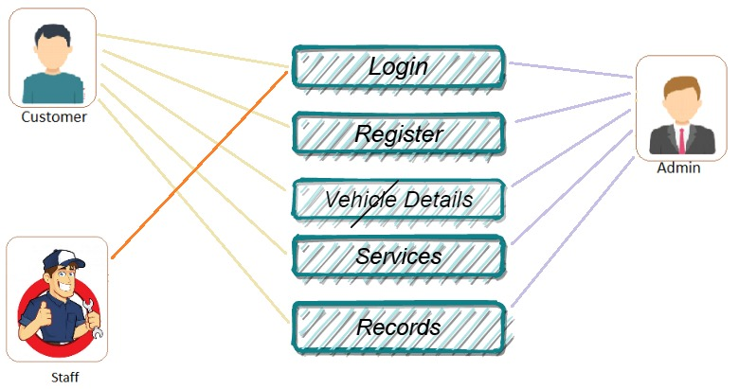
UML Diagram:
9

Slide 10
The UML Diagram shows that there three actors in the web application i.e. Admin, Staff, Customer.
The Admin is the super manager who can manage all the operations.
The Staff is only able to login and get the work done assigned by the admin.
The customer can login, register, and book the service.

Slide 11
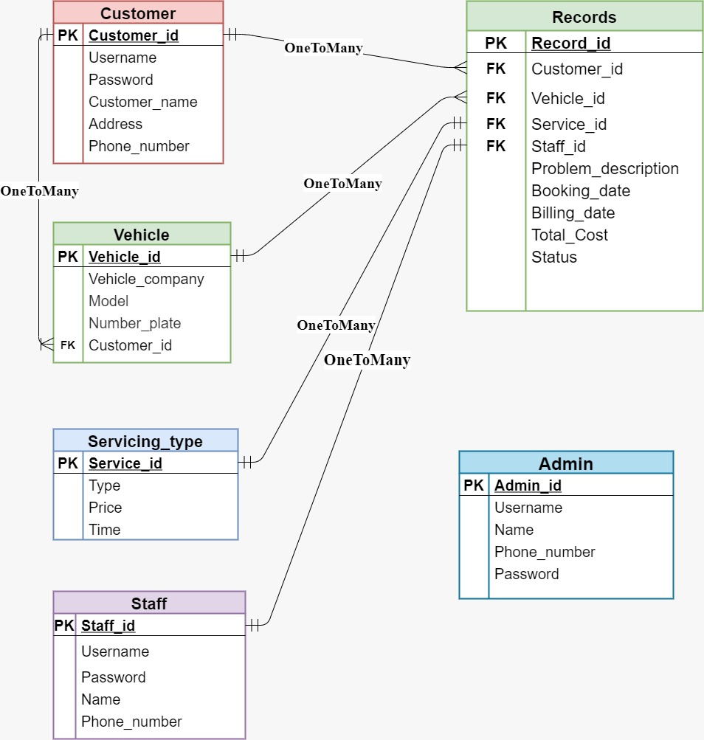
ER Diagram:
11

Slide 12
Application Flow:
The application mainly focuses on the three components i.e. the home panel, admin panel and the customer panel.
The home component consist of the home landing page, services, about us and all the navigation links.
In the home panel all the services are shown.
The contacting and the information about the application is also showcased.
12

Slide 13
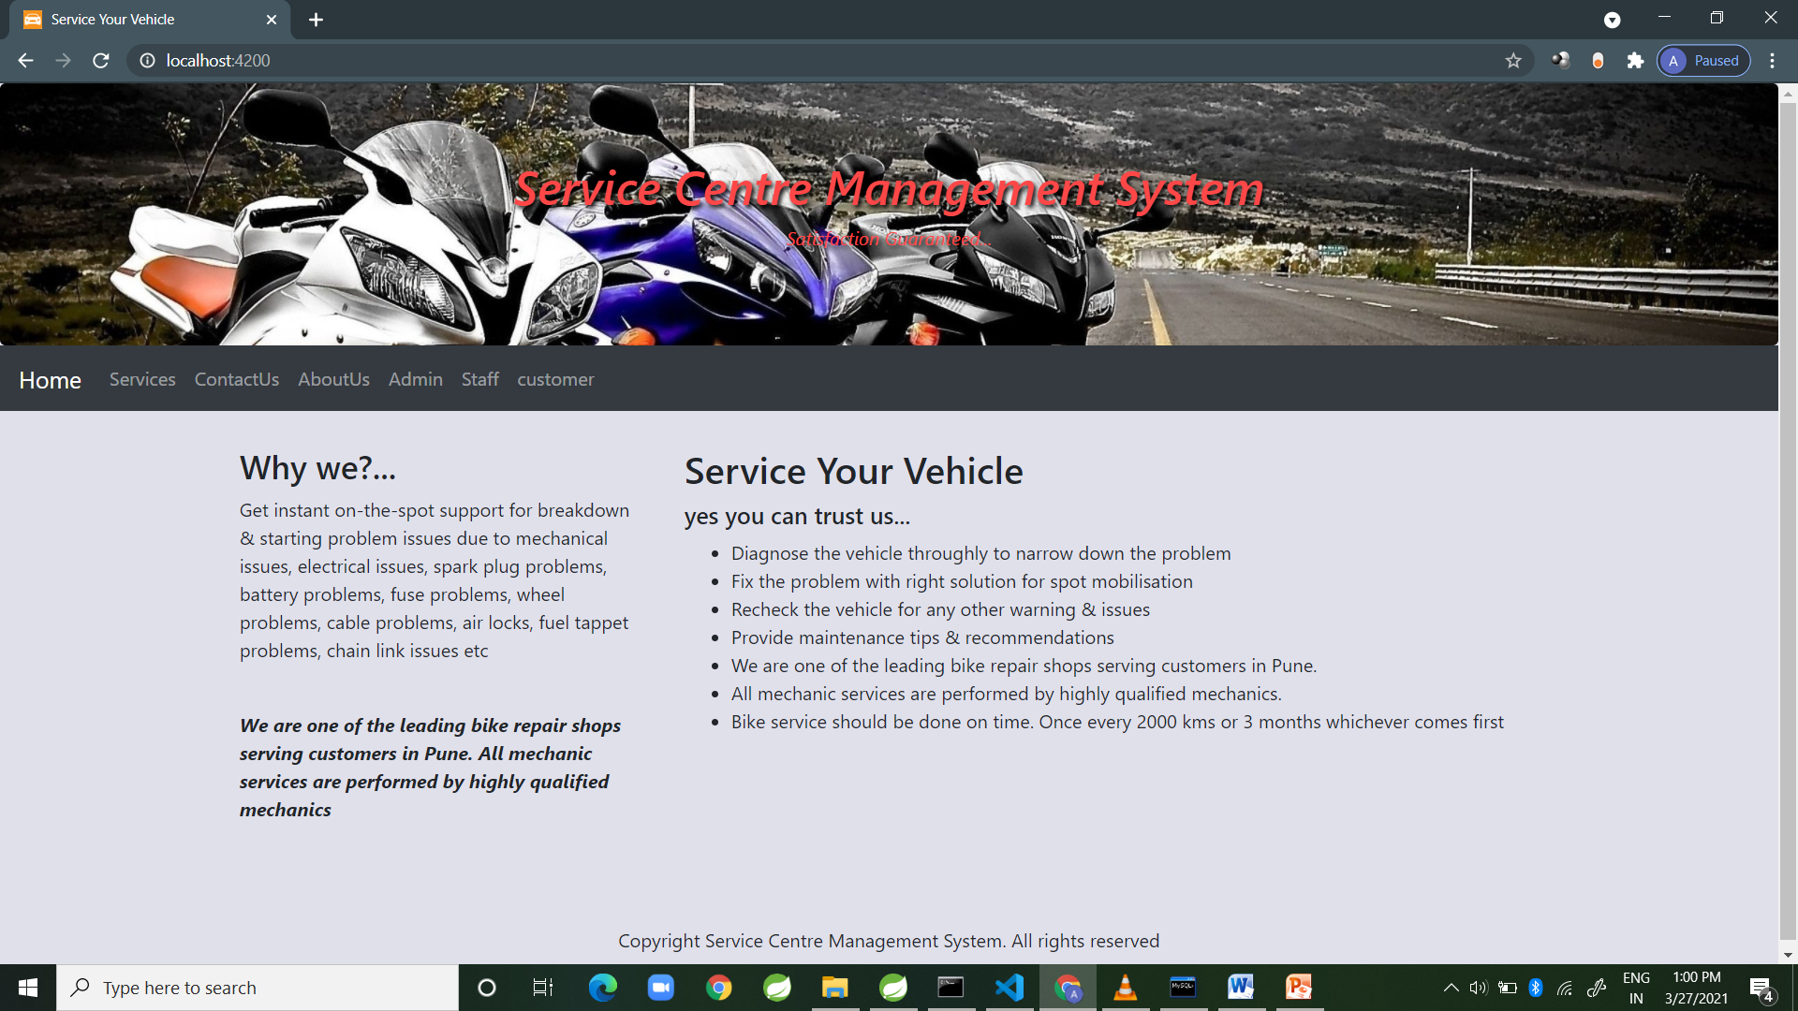
Home Page:
13

Slide 14
Whenever a customer visits the website he/she can look for the services provided by us, but won’t be able to book as he is not logged in yet.
If the he/she is not the existing customer the he/she must first register him/her self to book the service.
For the successful login by any existing customer following will be shown from where he/she can see his details and can book the service according to their choice.

Slide 15
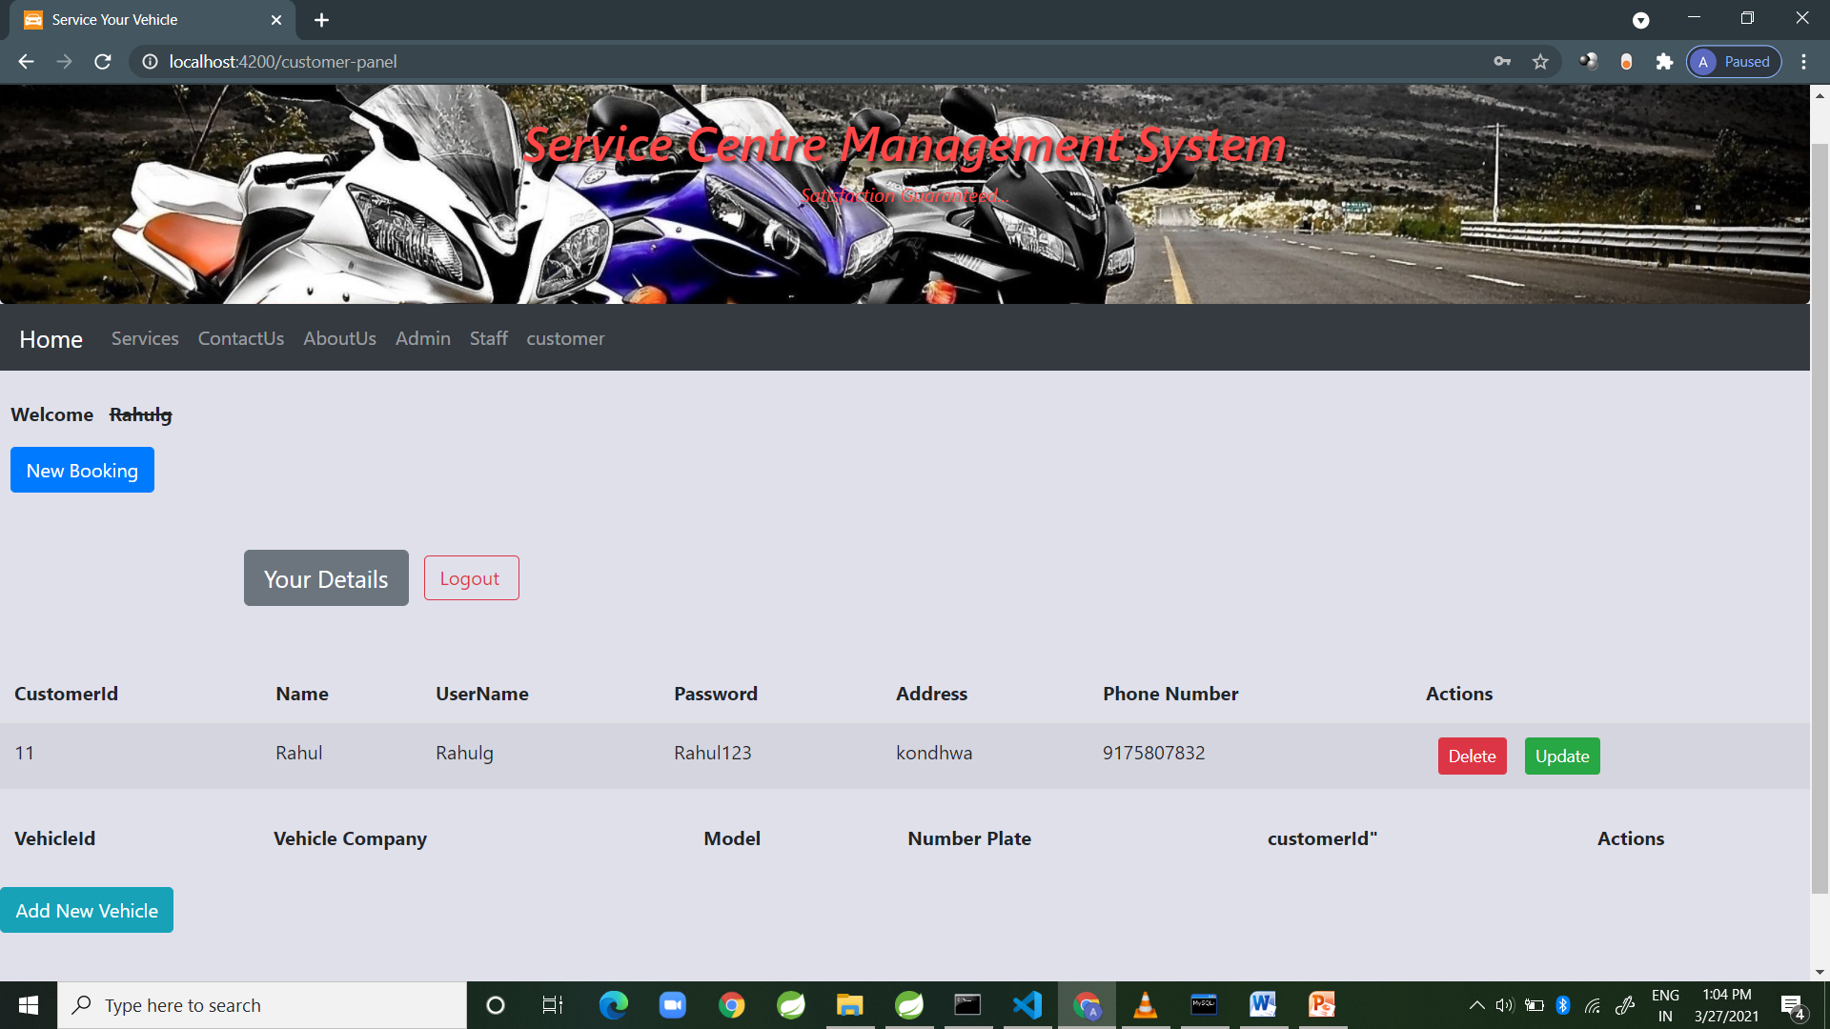

Slide 16
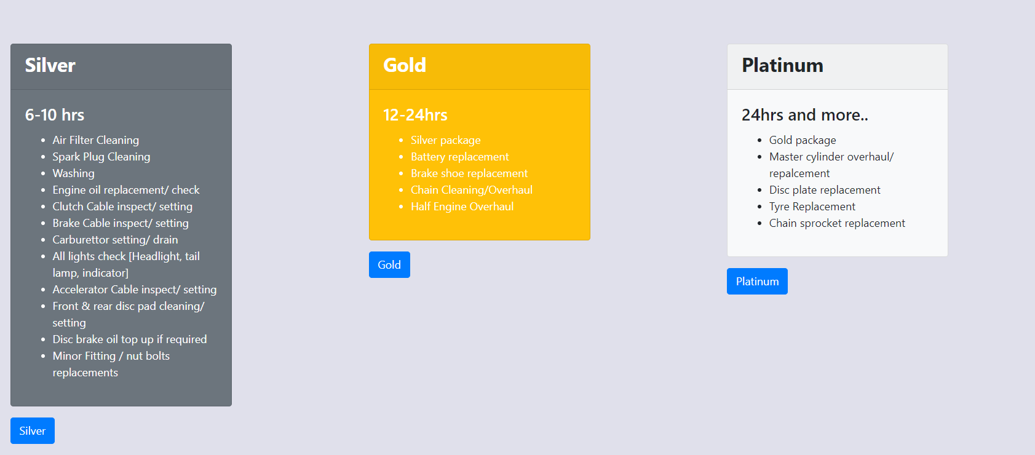
After clicking on the new booking the following three services will be shown and the customer can book any one of them according to their need.

Slide 17
The next comes is the admin panel from where in all the managing operations are performed by the admin.
The admin can here do all the manipulation required to maintain the proper working of the system
But for performing each and every change the admin needs to be logged in.
The admin panel looks like below…..

Slide 18
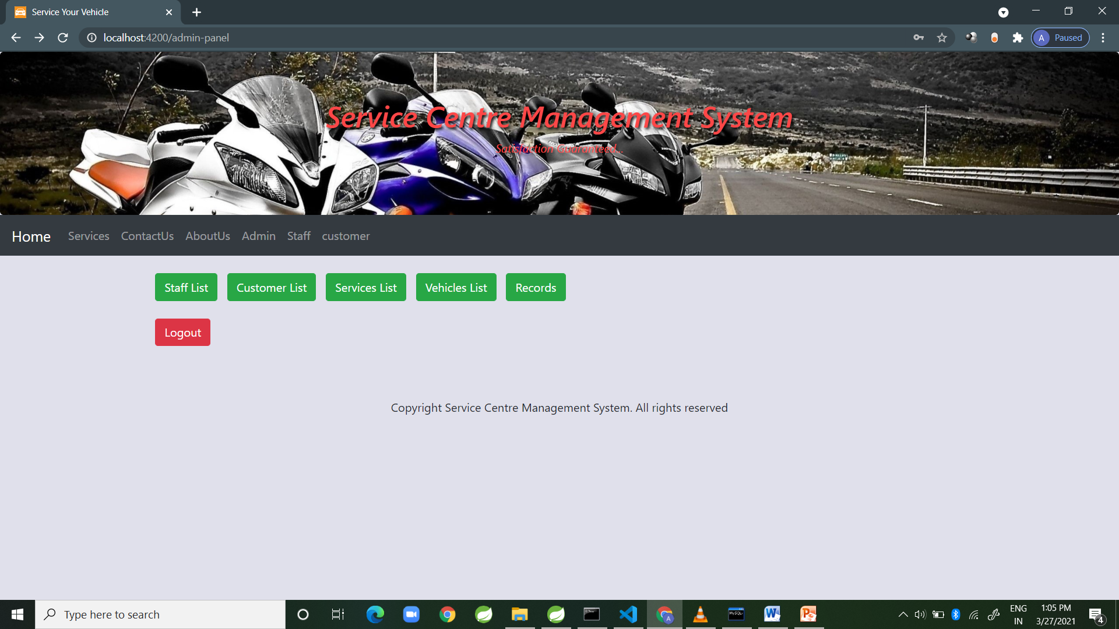
Here the admin is able to perform any sort of changes on any of the functions associated within the system.
The figure below shows the manipulation performed by the admin on the customers.

Slide 19
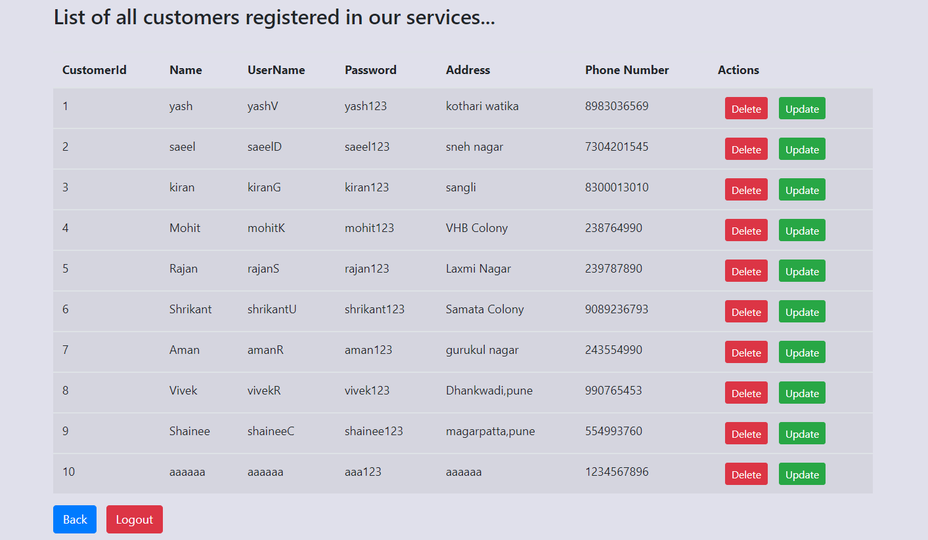

Slide 20
The next comes is the staff panel.
The staff here cannot register himself as the staff must be hired by some higher authority.
So the staff is hired by the admin.
The staff is assigned the work by the admin.
The below shows the staff registration form.

Slide 21
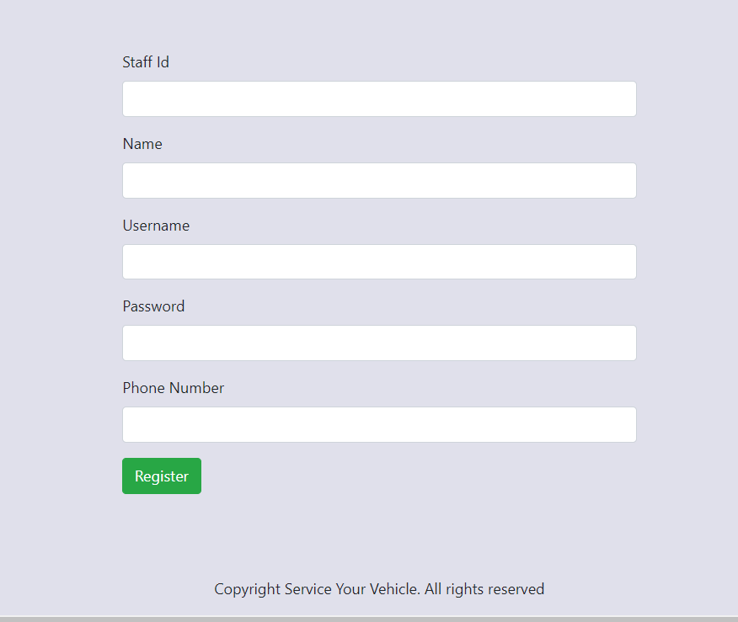

Slide 22
Once the booking is done by the customer the record id gets generated along with all the details of that particular customer.
The customer’s that booking will be pending untill the admin logs in and confirms the booking.
The admin will first confirm the booking and then assign the same task to the staff accordingly.

Slide 23
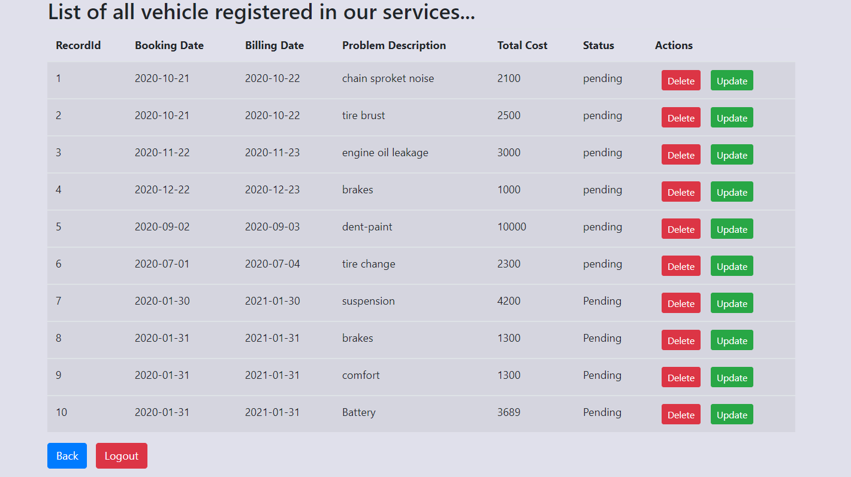

Slide 24
Backend Technologies:
The rest services are developed in the spring boot using the jpa repositories.
The rest services fetches the requi0red data from the database which is developed by using MYSql.
24

Slide 25
Future Scope:
The application currently lags the billing method.
To extend this a billing gateway can be added so that the customer won’t even have to go anywhere and do all the things online only.
25

Slide 26
Conclusion:
The package was designed in such a way that future modifications can be done easily. The following conclusions can be deduced from the development of the project.
Automation of the entire system improves the efficiency
It effectively overcomes the delay in communications .
Updating of information becomes so easier.
The System has adequate scope for modification in future if it is necessary.
26

Slide 27
Thank You..

